Slide 1

Final Presentation

Slide 2
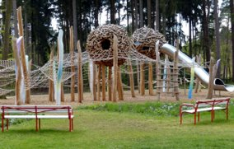
Final Presentation
By now you should have a playground animation which you can render out.
Depending on the available software there are a few options you can use to do this so ask your teacher what is the best option.

